Slide 1

Singapore
Maths
Workshop
Monday 26th February 2018

Slide 2
Agenda
Attitudes towards Maths
What is Singapore Maths?
Maths in Early Years
Suggestions to support learning at home
Questions

Slide 3
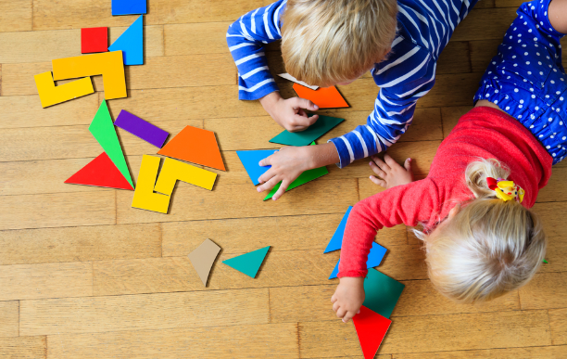
Is this Maths?
Notes:
You might see it as though the children are just playing. Questioning and language, shapes, patterns, colours, size, making new shapes

Slide 4
Our attitudes
Peoples’ attitudes towards maths depends on their experiences of it
Can’t do it approach
British culture adopts this idea that you are either a ‘Maths person’ or an ‘English person’
Some have a fear of ‘getting it wrong’
Pointless maths
At school, you were probably shown or told ‘this is how to do it’
Notes:
Analogy – compare maths to a boxer, skipping is an integral part of their training and preparation for a fight, but they don’t skip when they get into the ring. Maths training and prepares our brain to think, reason and problem solve.

Slide 5
The teaching of mathematics has changed drastically and this is one of the main reasons why we have adopted the Singapore Maths approach.
We now know much more about how children learn e.g. hands on, practical, visual, through play.
There is greater emphasis on understanding rather than rote learning of simple processes.
We understand and take account that learning is not a race; everyone's brain works at its own pace.
It is important that children are secure with the number system.
Problem Answer
Process

Slide 6
Why Singapore?
Many schools have implemented Singapore Maths
Asian culture adopts a ‘can do’ attitude
For the last 30 years, Singapore have had the highest achieving students in international rankings for maths
The style of teaching develops a deeper understanding of numbers and patterns
Children develop their reasoning skills

Slide 7

Task 1
Give each person a number

Slide 8
Maths In early years
Early Years Foundation Stage Mathematics Consists of two parts:
Number
Shape, space and measure
Throughout the year, we teach against the Early Learning Goals (ELGs) and by the end of the year, the children who achieve the ELGs have reached the expected level.

Slide 9
Number
Recognises numerals 0-10 then 10-20
Count objects, actions and sounds up to 10, then 20
Estimates how many objects are in a group and checks
Finds the total number of objects in two groups
Finds one more and one less from a group of objects
Uses the vocabulary involved in adding and subtracting
Adds and subtracts two single digit numbers
Count on and back from any number between 0 and 20
Solve problems involving doubling, halving and sharing
ELG
Children count reliably with numbers from one to 20, place them in order and says which number is one more and one less than a given number. Using quantities and objects, they add and subtract two single-digit numbers and count on or back to find the answer. They solve problems including doubling, halving and sharing.

Slide 10
Shape, Space and measure
Uses positional language e.g. behind, next to, in between
Uses mathematical names for 3D and 2D shapes
Describe shapes using the terms curve, straight, side, corners, edges, faces
Selects a particular named shape
Use everyday language related to time
Orders two or three items by size, length, height, weight capacity
Uses familiar objects and common shapes to create patterns and build models
Begins to use everyday language related to money
Orders and sequences familiar events
Measures short periods of time in simple ways
ELG
Children use everyday language to talk about size, weight, capacity, position, distance, time and money to compare quantities and objects and to solve problems. They recognise, create and describe patterns. They explore the characteristics of everyday objects and shapes and use mathematical language to describe them.

Slide 11
Monsters inc Maths
In the past, we have focused on one outcome at a time.
We usually teach number and shape, space and measure separately.
However, the Singapore Maths approach to teaching allows us to cover lots of different outcomes by focusing on one number at a time.
We have incorporated ‘Monsters Inc’ into our Maths lessons and each monster is associated with a number.

Slide 12
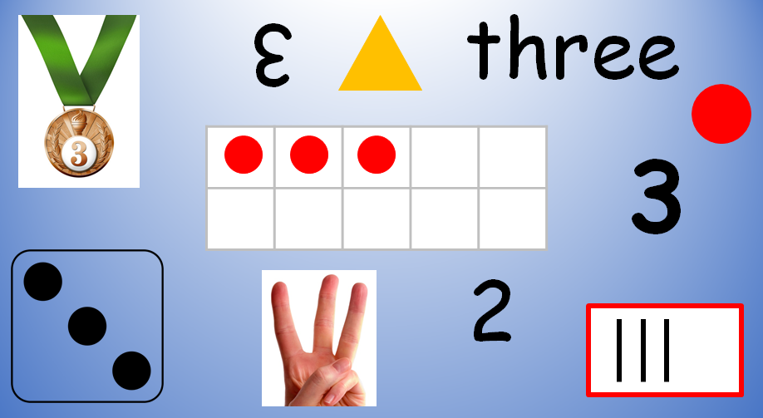
Threeness of thee
Focus and explore everything about the number 3
Deeper understanding of the number
Taking children’s learning outwards rather than upwards

Slide 13
Introducing number 8
Children are introduced to a monster
Questions are asked
Monsters are used in number stories and problems
This is repeated for each number
It is a systematic approach
We are constantly reinforcing learning and building on prior knowledge

Slide 14
How we teach
Questioning is important
Language – subtract not take away, number equation not sentence
Whole class inputs
Partners
Small group work
Low floor, high ceiling tasks
Maths in the continuous provision through play and exploration
Tens frames
Whole part diagrams
Journals – children are given the opportunity to draw their maths
resources

Slide 15
Concrete, Pictorial, abstract Approach
CPA is a highly effective approach to teaching that develops a deep and sustainable understanding of maths.
Concrete – the ‘doing’ stage, problems are brought to life by allowing children to experience and handle physical (concrete) objects.
Pictorial – the ‘seeing’ stage, visual representations of concrete models are used to model problems. This encourages children to make a mental connection between the concrete object and the pictorial representations.
Abstract – the ‘symbolic’ stage, children use abstract symbols to model problems.

Slide 16
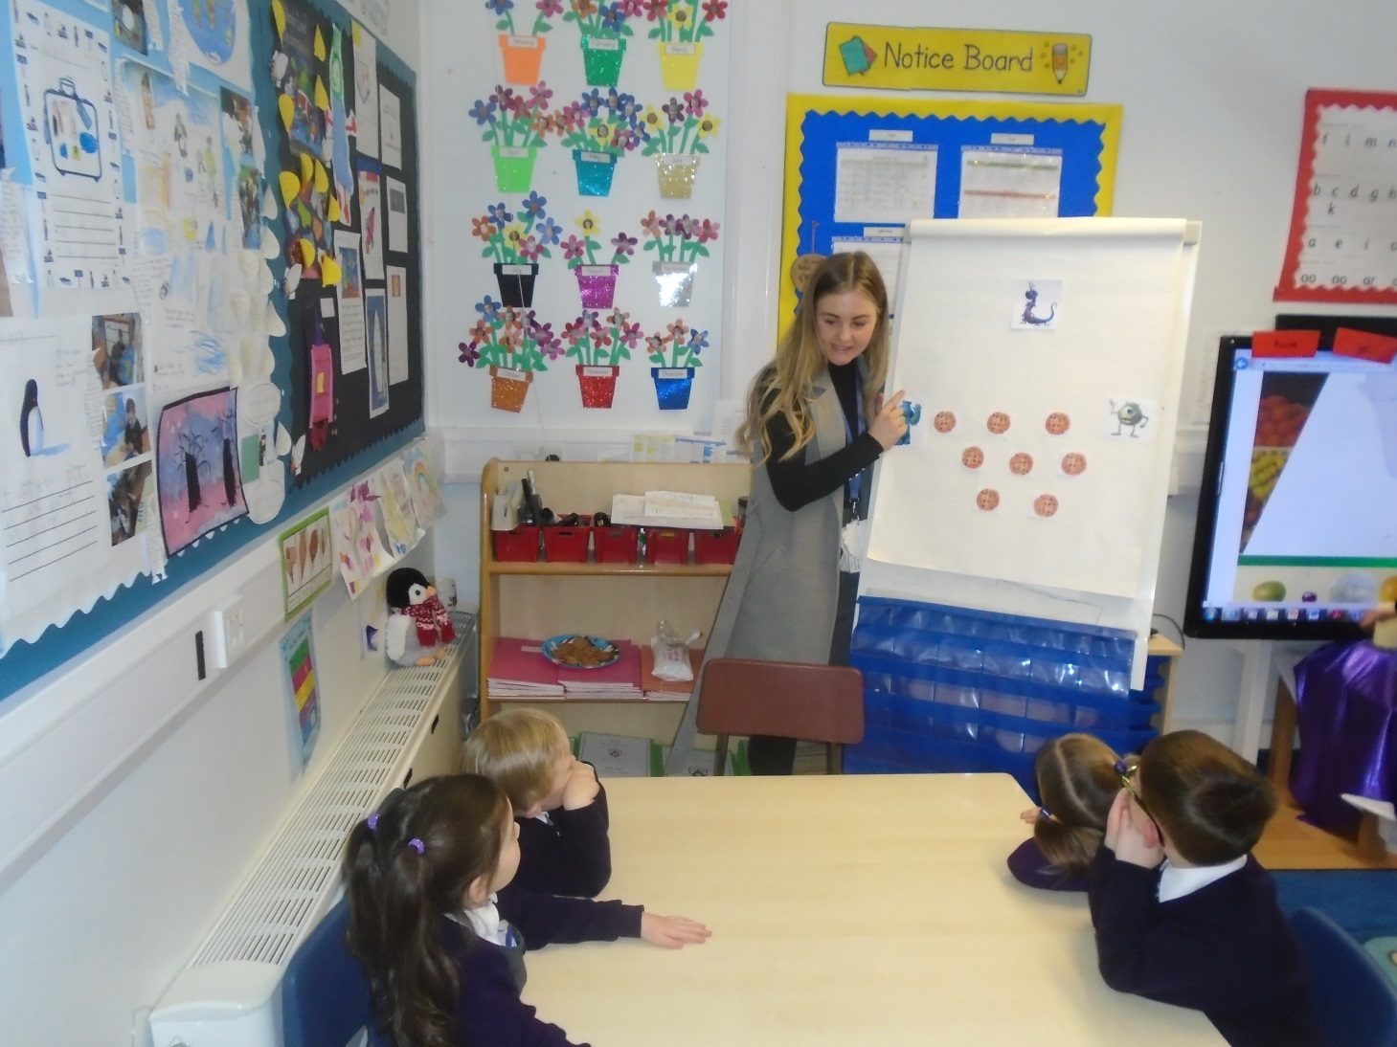
CPA in the classroom

Slide 17
Supporting at home
Recognising numbers and shapes in the environment
Exploring coins
Setting the table
Time to the hour
Problems
Asking children to reason and to draw their maths
Websites – topmarks.co.uk, crickweb.co.uk, ictgames.co.uk
The focus of this half term’s Stay and Play is maths
Opportunity to explore the resources and complete maths activities with your child
Stay and play

Slide 18
Thank you for coming
Any questions?
“Just because something is difficult doesn’t mean you shouldn’t try, it just means you should try harder.”
“The only way to learn maths is to do maths.” his
“Mistakes are proof that you are trying.” this Maths?
“Even the hardest puzzle has a solution.”

